Slide 1
Mitigation of health and environmental risks related to e-waste dismantling in Metro Manila (2012-2016)
Dr. Guillaume Fauvel (MD, MPH)
General Coordinator- Medecins du Monde- France

Slide 2
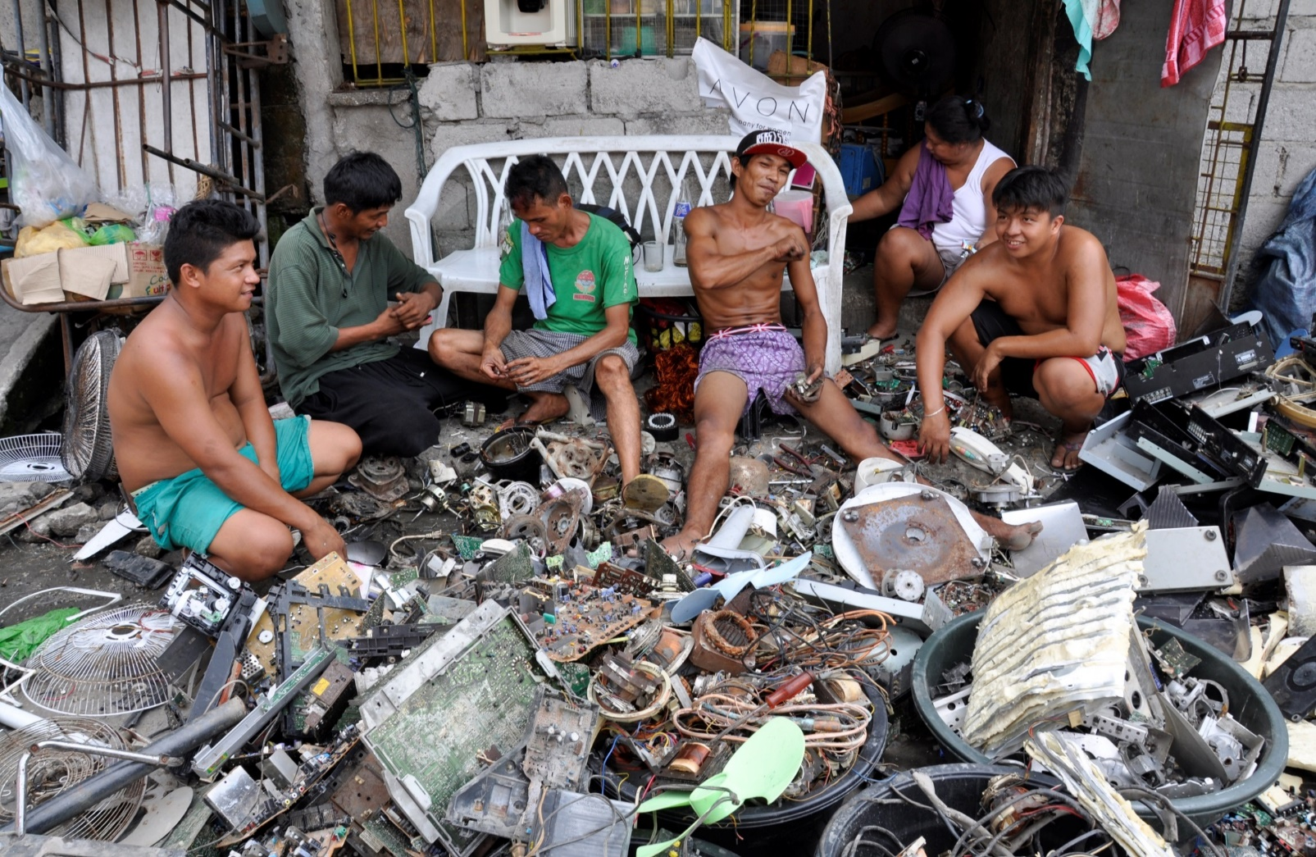
E-waste related issues
42 millions tons e-waste worldwide in 2014
Environmental and health risks:
Toxic components in e-waste: Pb, Cd, Hg, POPs, PCBs etc.)
Chronic and acute intoxications
E-waste and regulation:
Gap between regulation and e-waste management due to technical constraints, recycling cost…
Industrial e-waste → formal sector (low)
Household e-waste → informal sector
Dismantling for recycling:
For precious metals: gold, silver, copper, nickel, aluminium, etc.

Slide 3
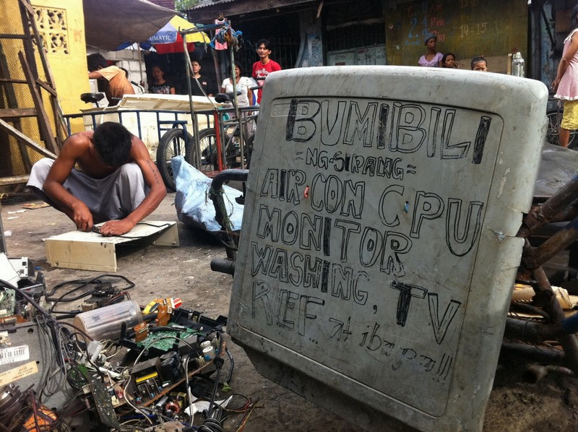
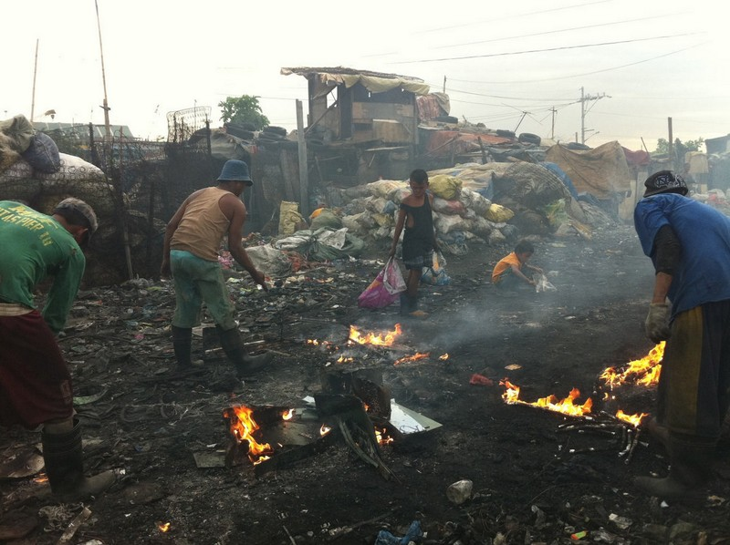
Risks for informal e-waste dismantlers
Risks related with practices:
CRT treatment and crushing
Cable burning,
Children in work places,
Hydgiene and security
Perception among e-waste dismantlers:
« Do you think e-waste recycling can adversely affect your health? » : No or minor effect = 80%
« Which recycling activities adversly affect your health? »
Burning (51%)
Crushing (16%)
Dismantling (12%)
Collection (12%)
No use of protection equipment (mask and gloves): 94%

Slide 4
MdM program 2012-2016
* Capulong, Manila
* Malabon, Barangay Longos
* Caloocan, Barangay Bagong Silang
* Caloocan, Barangay Camarin
Objectif: Contribute, in 3 to 5 years, to the mitigation of sanitary and environmental consequences of electronic and electrical waste informal recycling, among recyclers and their community in MetroManila.
E-waste dismantling related risks mitigation
Reduction of the exposure to toxic substances related with e-waste
Access to quality healthcare
Community capacity building

Slide 5
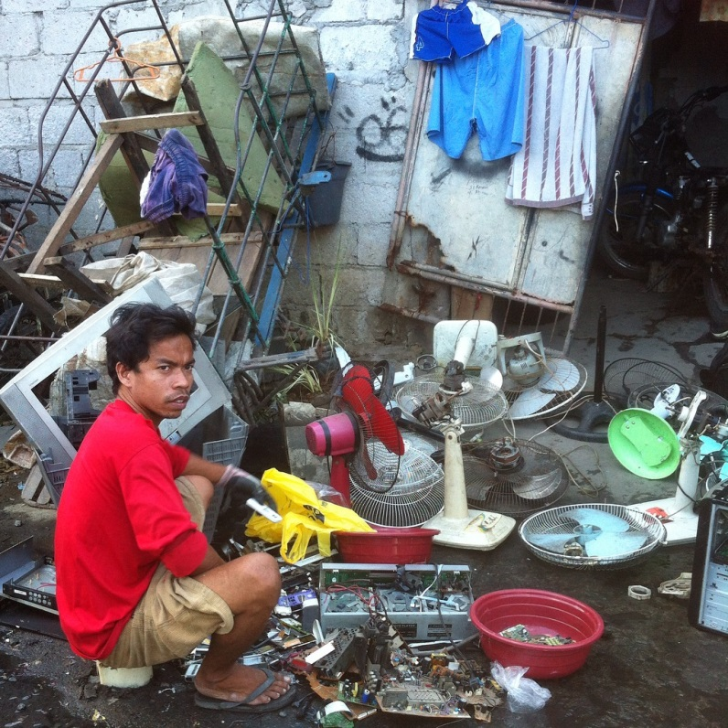
Activities and achievements
Mitigation of the individual and collective exposure :
IEC and BCC on:
Risks (toxics contained in the appliances, effects on health, dangerous practices)
Protection (safe practices, protection material, individual and social acceptance of safe behaviors)
Environmental protection (including waste management)
Specific activities for vulnerable groups (children, women of childbearing age)
Capacity building of barangay health workers and health authorities
Promotion and distribution of protection material (masks, glasses, gloves, boots)
Promotion of “safer recycling facilities”

Slide 6
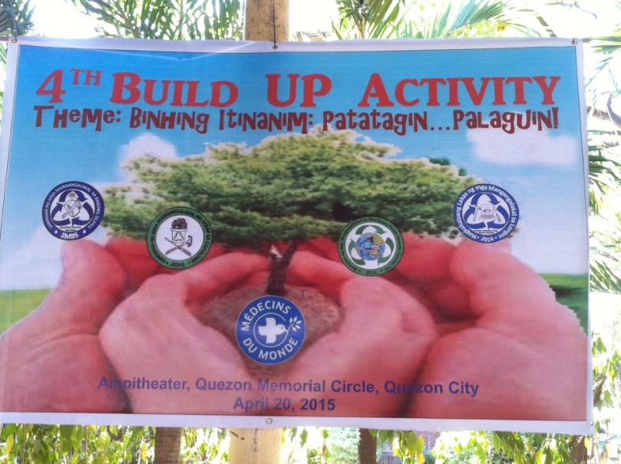
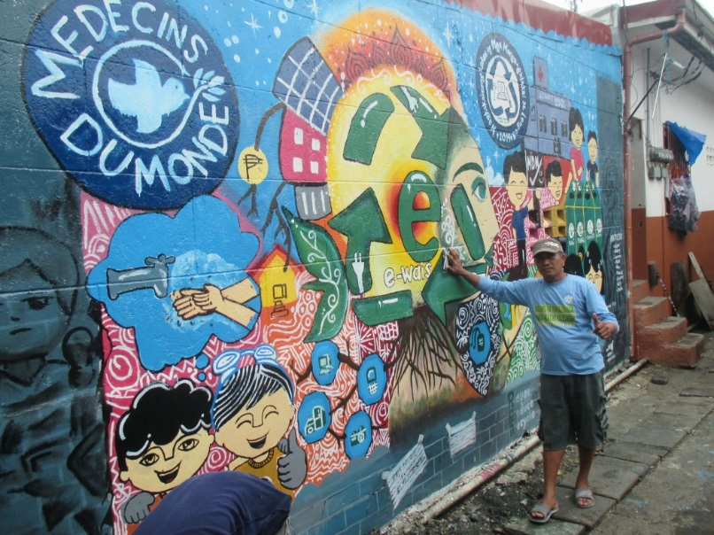
Activities and achievements
Community capacity building:
Promote the build-up of 4 cooperatives / People Organizations
Facilitate access to micro-finance and savings
Organize exchange of practices with other regional pilot programs (Toxic Links in India)
Advocacy for risk mitigation:
Improvement of the municipal management of the waste generated by the informal e-waste recycling
Promotion of the research on heavy metals contamination in humans and the environment (soil, water, air)

Slide 7
Activities and achievements
Acces to quality and apropriate healthcare:
Identification of recyclers health problems, referal and social support
Identification, screening, treatment and follow-up of mercury and lead poisoning. Partnership with the poison centers Follow-up by the mobile unit to ensure the end of the exposure and the compliance to treatment.
Reinforcement of 50 health professionals capacities on poisoning related with informal recycling activities (barangay health centre and local hospitals)
Awareness session for health professionals and authorities on environmental health issues

Slide 8
Capitalisation
Positive achievements :
Awareness raising amongst e-waste dismantlers
Environment protection and improvement around dismantling areas
Regular use of PPEs (gloves++)
Community mobilization, recognition of the informal sector
To be improved:
Protective measures’ impact on exposure and impregnation difficult to assess
Protection measures sustainability (PPEs, dismantling areas)
To be followed:
Context evolution especially in terms of regulation

Slide 9
Impact and Sustainability
2017-2019 – Focus on capacity building the 4 People Organizations - Focus on alternative livelihood creation through training, education, and micro-loans to move away from e-waste dismantling - Strengthening the organizational capacity of the POs - Formalization and accreditation of the POs
“It’s never too late to go to school and study. If we dream and work hard for it, nothing is impossible”
“I’m maybe old but my life doesn’t stop there; I still have to send my eight year old adopted daughter to school. There is still a lot to do”
- Nenita Dematera, 56 years old, PO treasurer in Capulong

Slide 10
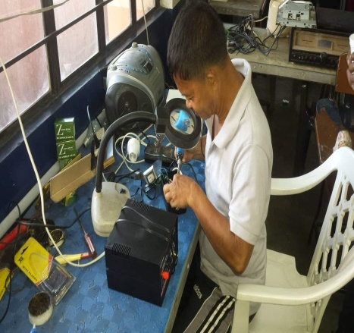
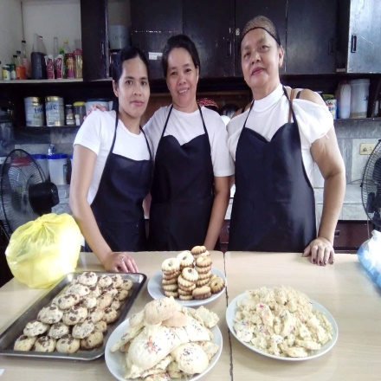
Three members enrolled in a 20-day Baking Class offered by the Manila Manpower Development Center (MMDC), with the support of FoMDM
Five members enrolled in a five weeks training repair television, electric fans and washing machines, through special arrangement between FoMDM and private school.
They received a micro loan from the PO to set up a workshop
Now instead of dismantling it they would try to repair it first and sell for better price. With this new skills acquired they found other means of earning and saving themselves from toxic exposure.
They received a micro loan from the PO to set up their own small bakery business
They have all fully paid back their loans, and expanding their business slowly enabling the family to move away from toxic e-waste dismantling while increasing their income level.

Slide 11
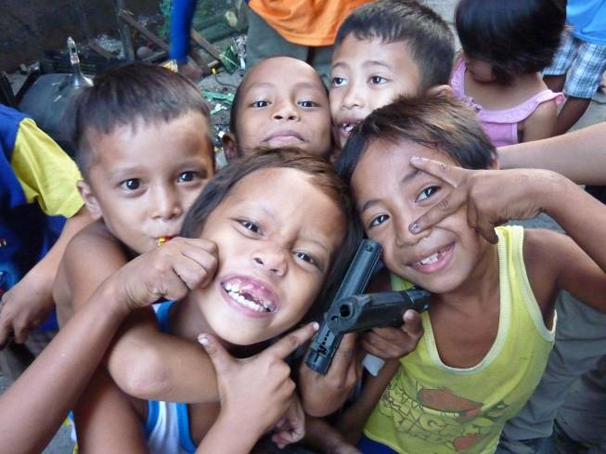
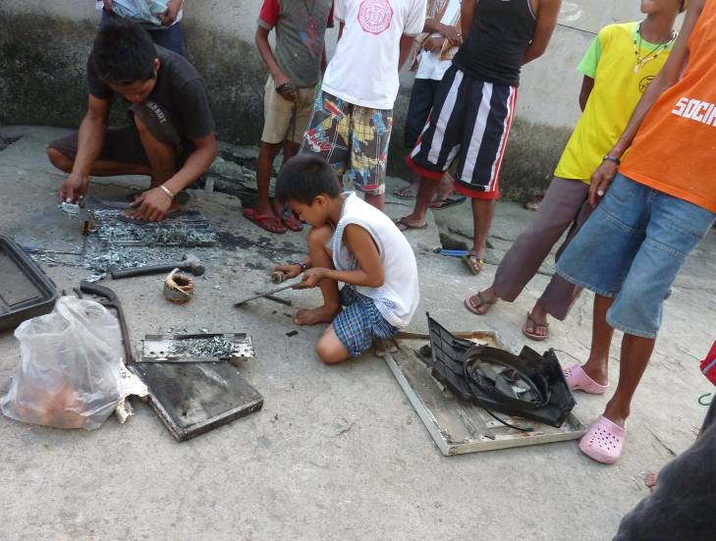
Thank you for your attention
More information: genco.philippines@medecinsdumonde.net

